Slide 1
Embedded Practice 1 SimCLR Implementation
September 14, 2020
Euntae Choi
euntae.choi175@gmail.com
Computing Memory Architecture Lab.
CSE, SNU

Slide 2
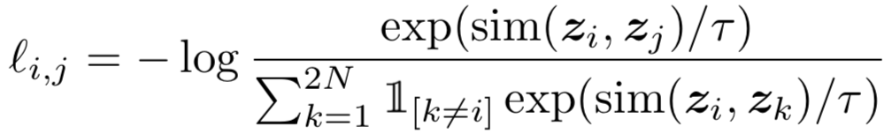
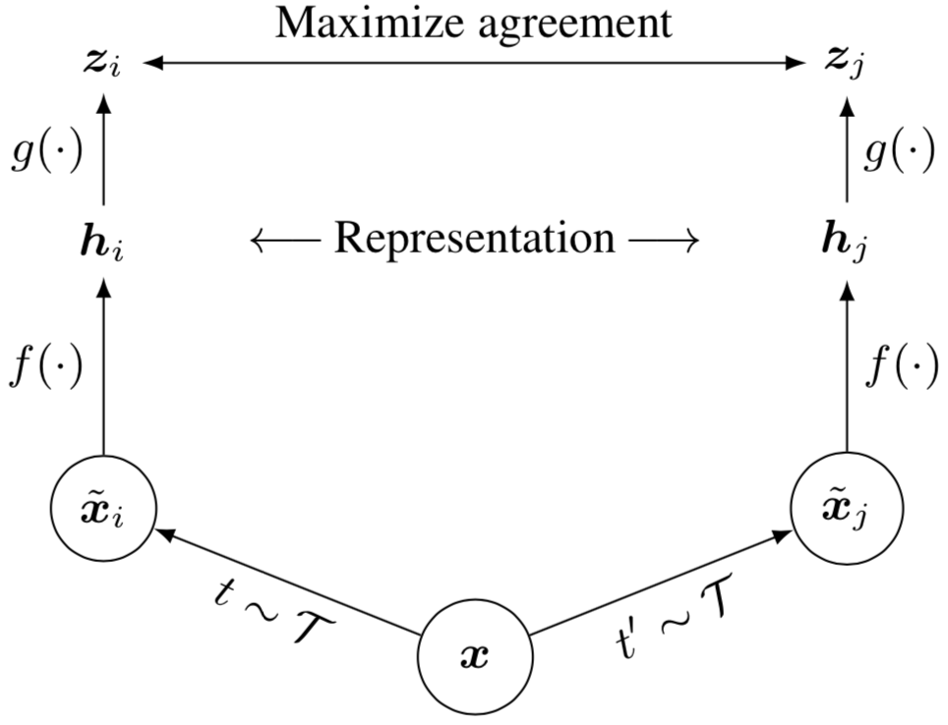
A Simple Framework for Contrastive Learning of Visual Representations
[Chen, 2020]
A combination of simple data augmentations, crop&resize, color distortion&blur
Stronger augmentation is useful in SSL
Representation h_{i}, before non-linear transformation to contrastive loss, is later used for downstream tasks
Within-batch negative sampling and, thus, large batch is favored to increase # negative samples
2-layer MLP
ResNet-50
Crop&resize, color&blur

Slide 3
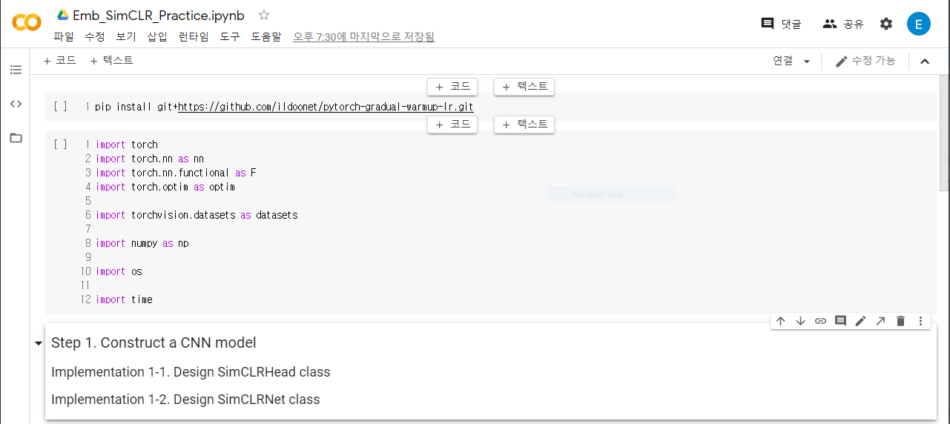
Colab Setup
Go to https://colab.research.google.com/
Select ‘업로드’
Upload the notebook file downloaded from eTL
If you can see the contents as below, loading is done!
‘런타임’ tab->’런타임 유형 변경‘->하드웨어 가속기 ‘GPU’로 변경->’저장’

Slide 4
Overview
1. Construct a CNN model
f: the convolutional trunk of standard ResNet
g: a 2-layer MLP as projection head
h: a single linear layer as classifier
2. Prepare datasets & data augmentations
We’ll use CIFAR-10 train data
Augmentations: mainly from torchvision
3. Implement NTXent loss (if time allows)
Skeleton code & a simple guide are provided
(so that you can implement it on your own after this session)
4. Run pre-training step
Instantiate your model
Implement a basic training loop
5. Run linear evaluation step (homework)
Extract features from frozen f
Then fine-tune only the classifier

Slide 5
1. Construct a CNN Model
We’ll use a CIFAR-version of ResNet as convolutional feature extractor f
1 conv stem + 3 Res blocks + bn + relu + avgpool (total depth=26)
The final feature dimension is 64
Add a 2-layer MLP projection head g
(64) -> Linear -> (64) -> ReLU -> Linear -> (emb_dim) -> L2 normalization
Embedding dimension is 32
Add a linear classifier h
(64) -> Linear -> (10)
g
emb
f
feat
h
logit

Slide 6
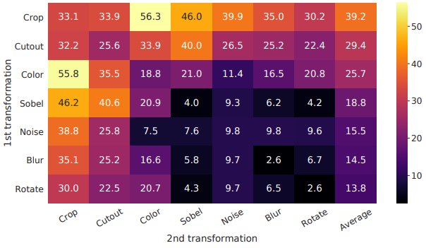
2. Prepare dataset & data augmentations
We’ll use CIFAR-10
Use CIFAR10 dataset class (already implemented in PyTorch)
Follow the SimCLR paper for data augmentations (detailed instructions in the notebook)
Random crop & resize
Color jitter
Color drop (gray scale)
Gaussian blur
Explanation on why use the combination above?
⇒ https://arxiv.org/pdf/2007.13916.pdf

Slide 7
3. Implement NTXent loss
Let’s interpret this function
Basically, this loss function is NLL (negative log likelihood)
Inside the log function, the likelihood is constructed as softmax function with:
a single positive pair (i & j)
(2N-2)-many negative pairs
Each logit value is pairwise similarity (cosine similarity in this case)
...
These similarity values (1 pos & 2N-1 negs) construct a single probability vector
(as in standard supervised classifier training)

Slide 8
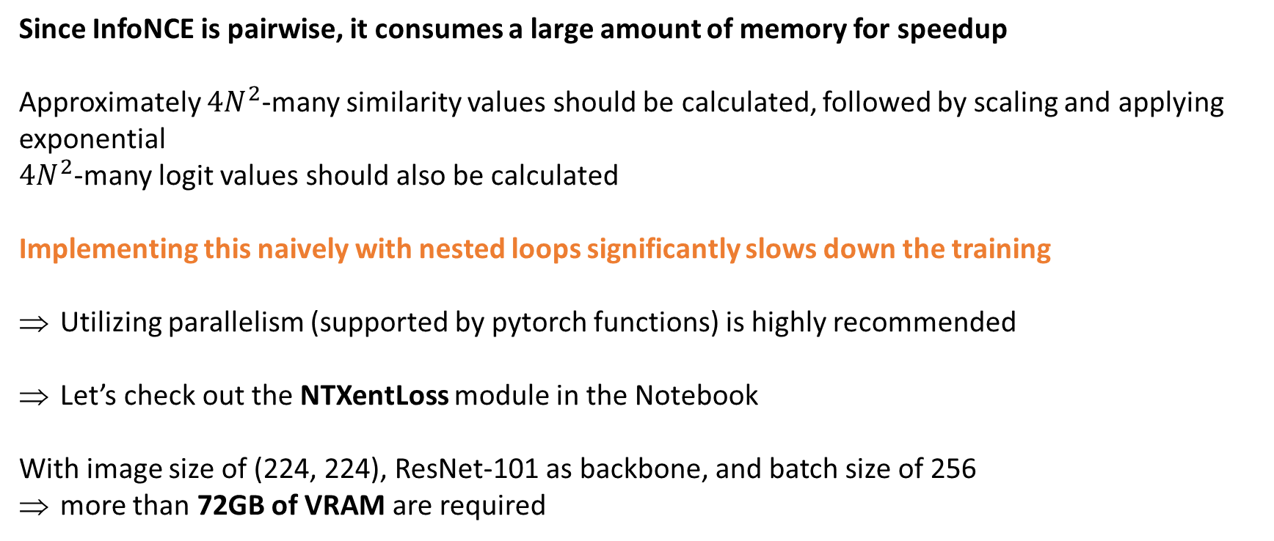
3. Implement NTXent loss
Since InfoNCE is pairwise, it consumes a large amount of memory for speedup
Approximately $4N^{2}$-many similarity values should be calculated, followed by scaling and applying exponential
$4N^{2}$-many logit values should also be calculated
Implementing this naively with nested loops significantly slows down the training
Utilizing parallelism (supported by pytorch functions) is highly recommended
Let’s check out the NTXentLoss module in the Notebook
With image size of (224, 224), ResNet-101 as backbone, and batch size of 256
more than 72GB of VRAM are required

Slide 9
4. Run pre-training step
Optimizer: LARS (https://arxiv.org/pdf/1708.03888.pdf)
lr = 0.1 * batch_size / 256 (linear scaling)
momentum = 0.9
weight_decay = 1e-6
Scheduler: linear warmup scheduling (especially when dataset of choice is large)
Typically warmup lr for 1/10 of total training epochs
After that, apply cosine decay without restart
⇒ Total 200 epochs, 20 warmup epochs, and 180 cosine decay epochs
When implemented correctly, an epoch takes about 1 minute and ~1.5GB of VRAM w/
batch_size = 256
ResNet-26 (modified for datasets w/ small image size)
Single GPU (K80 or P100)

Slide 10
Homework
Due date: Sep. 28th
Report file format: .pdf or .docx
File name: <YOUR STUDENT ID> <YOUR NAME> Practice 1
ex) 2020-12345 XXX Practice 1.docx
No requirement on report template
3 parts - please refer to the page 11~13 of this material
If you have any question, please send an e-mail to euntae.choi175@gmail.com

Slide 11
Homework (1) - 4pts
Complete the codes for pre-training
Follow all the implementation instructions in the notebook
Modify your code so that loss values can be accessed after training
Run pre-training step (DO NOT CHANGE ANY HYPERPARAMETER)
Report the following:
Training loss curve (4pts)
You can use any library for plotting
! The final loss value must be smaller than 1.7 (otherwise your score will be zero)

Slide 12
Homework (2) - 3pts
Implement linear evaluation protocol
Load the model trained in the pre-training step
Freeze the feature extractor f
Train only the linear classifier h with CE loss & the labels from training data
You can use any hyperparameter/optimizer/scheduler
Adam w/ lr=1e-3 or 1e-4 is recommended as your first trial
Test the final model (f & h) on the test set of CIFAR-10
Report the following:
The training setting you used in this step (1pt)
Briefly explain hyperparameters of your choice
The final test accuracy (2pts)
! The accuracy value must be larger than 60% (if not, the score will be zero)

Slide 13
Homework (3) - 3pts
Do ablation studies on pre-training step
! YOU MUST FIX ALL SETTINGS FOR LINEAR EVALUATION
Sweep the batch size (temperature=0.07): [64, 128, 256, 512, ...] (until the VRAM allows)
Sweep the temperature (batch size=256): [0.01, 0.05, 0.1, 0.5, 1.0]
Sweep the number of pre-training epochs (temp=0.07, batch=256): [100, 200, 300, 400]
For each case, report the following:
accuracy vs sweeping value curve (or table) for 3 cases (batch size, temperature, pre-training epochs) - 1pt for each curve (or table)

Slide 14
Term project examples
Implement two or more SSL methods & Make comparison with SimCLR
SCL: https://arxiv.org/pdf/2004.11362.pdf
BYOL: https://arxiv.org/pdf/2006.07733.pdf
MoCo: https://arxiv.org/pdf/1911.05722.pdf
Model capacity vs. Accuracy
# of training epochs vs. Accuracy
...
Reproduce SSL method (wav2vec) for ASR
https://arxiv.org/pdf/1904.05862.pdf
You can work on existing ASR frameworks (kaldi or fairseq)
Only the model & loss function need to be implemented
Use 80h of Librispeech for training / 10h of TEDLIUM v1 for test
(Details will be fixed soon)

